Slide 1
CMSC201
Computer Science I for Majors
Lecture 09 – For Loops

Slide 2
Last Class We Covered
Lists and what they are used for
  Operations a list can perform
  Including append() and remove()
Two dimensional lists
Sentinel loops
  Priming read (and non-priming read)

Slide 3
Any Questions from Last Time?

Slide 4
Today’s Objectives
To learn about and be able to use a for loop
  To understand the syntax of a for loop
  To use a for loop to iterate through a list
  To perform an action a set number of times
To learn about the range() function
To be able to combine range() and for

Slide 5
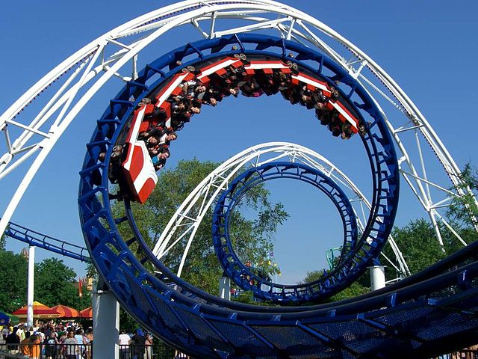
Looping
(for Loops)
Looping
(for Loops)
Image from wikipedia.org
Notes:
https://en.wikipedia.org/wiki/File:Corkscrew_(Cedar_Point)_01.jpg

Slide 6
Control Structures (Review)
A program can proceed:
  In sequence
  Selectively (branching): make a choice
  Repetitively (iteratively): looping
  By calling a function
focus of today’s lecture

Slide 7
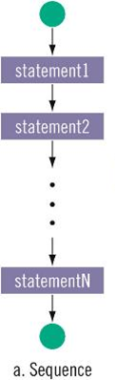
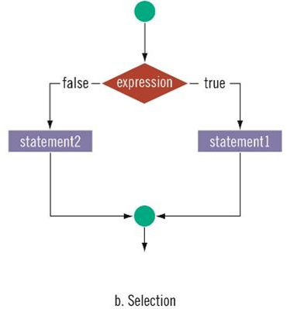
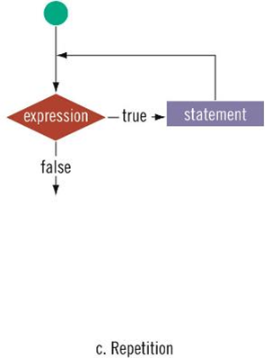
Control Structures: Flowcharts
focus of today’s lecture

Slide 8
Looping
Python has two kinds of loops, and they are used for two different purposes
The while loop
  Works for basically everything
The for loop:
  Best at iterating over a list
  Best at counted iterations
what we’re covering today

Slide 9
String Operators in Python
Operator | Meaning
+ | Concatenation
* | Repetition
STRING[#] | Indexing
STRING[#:#] | Slicing
len(STRING) | Length
 | Iteration
for VAR in STRING
covering today

Slide 10
Review: Lists and Indexing

Slide 11
Review: List Syntax
Use [] to assign initial values (initialization)
  myList = [1, 3, 5]
  words = ["Hello", "to", "you"]
And to refer to individual elements of a list
  >>> print(words[0])
  Hello
  >>> myList[0] = 2

Slide 12
Review: Indexing in a List
0 | 1 | 2 | 3 | 4 | 5
??? | ??? | ??? | ??? | ??? | ???
Remember that
list indexing starts
at zero, not 1!
  animals = ['cat', 'dog', 'eagle', 'ferret',
  'horse', 'lizard']
  print("The best animal is a", animals[3])
  animals[5] = "mouse"
  print("The little animal is a", animals[5])
  print("Can a", animals[4], "soar in the sky?")

Slide 13
Review: Indexing in a List
0 | 1 | 2 | 3 | 4 | 5
cat | dog | eagle | ferret | horse | lizard
  animals = ['cat', 'dog', 'eagle', 'ferret',
  'horse', 'lizard']
  print("The best animal is a", animals[3])
  animals[5] = "mouse"
  print("The little animal is a", animals[5])
  print("Can a", animals[4], "soar in the sky?")
The best animal is a ferret
The little animal is a mouse
Can a horse soar in the sky?
mouse

Slide 14
for Loops: Iterating over a List

Slide 15
Remember our Grocery List?
def main():
print("Welcome to the Grocery Manager 1.0")
# initialize the value and the size of our list
grocery_list = [None]*3
grocery_list[0] = input("Please enter your first item: ")
grocery_list[1] = input("Please enter your second item: ")
grocery_list[2] = input("Please enter your third item: ")
print(grocery_list[0])
print(grocery_list[1])
print(grocery_list[2])
main()
We used a while loop to fix this, but we can also use a for loop

Slide 16
Iterating Through Lists
Iteration is when we move through a
list, one element at a time
  Iteration is best completed with a loop
  We did this previously with our while loop
Using a for loop will make our code
much faster and easier to write
  Even faster than the while loop was to write!

Slide 17
Parts of a for Loop
Here’s some example code… let’s break it down
  myList = ['a', 'b', 'c', 'd']
  for listItem in myList:
  print(listItem)

Slide 18
Parts of a for Loop
Here’s some example code… let’s break it down
  myList = ['a', 'b', 'c', 'd']
  for listItem in myList:
  print(listItem)
initialize the list
how we will refer to each element
the list we want to iterate through
the body of the loop

Slide 19
How a for Loop Works
In the for loop, we declared a
new variable called “listItem”
  The loop changes this variable for us
The first time through the loop, listItem
will be the first element of the list ('a')
The second time through the loop, listItem will be the second element of the list ('b')
And so on…

Slide 20


for Loop Explanation
  myList =
  for listItem in myList:
  print(listItem)
"a"
"b"
"c"
"d"
0
1
2
3
Image from pixabay.com

Slide 21
for Loop Explanation
  myList =
  for listItem in myList:
  print(listItem)
"a"
"b"
"c"
"d"
0
1
2
3
"a"
listItem
Image from pixabay.com

Slide 22
for Loop Explanation
  myList =
  for listItem in myList:
  print(listItem)
"a"
"b"
"c"
"d"
0
1
2
3
"a"
listItem
a
output:
Image from pixabay.com

Slide 23
for Loop Explanation
  myList =
  for listItem in myList:
  print(listItem)
"a"
"b"
"c"
"d"
0
1
2
3
"a"
"b"
listItem
Image from pixabay.com

Slide 24
for Loop Explanation
  myList =
  for listItem in myList:
  print(listItem)
"a"
"b"
"c"
"d"
0
1
2
3
"b"
listItem
b
output:
Image from pixabay.com

Slide 25
for Loop Explanation
  myList =
  for listItem in myList:
  print(listItem)
"a"
"b"
"c"
"d"
0
1
2
3
"b"
"c"
listItem
Image from pixabay.com

Slide 26
for Loop Explanation
  myList =
  for listItem in myList:
  print(listItem)
"a"
"b"
"c"
"d"
0
1
2
3
"c"
listItem
c
output:
Image from pixabay.com

Slide 27
for Loop Explanation
  myList =
  for listItem in myList:
  print(listItem)
"a"
"b"
"c"
"d"
0
1
2
3
"c"
"d"
listItem
Image from pixabay.com

Slide 28
for Loop Explanation
  myList =
  for listItem in myList:
  print(listItem)
"a"
"b"
"c"
"d"
0
1
2
3
"d"
listItem
d
output:
Image from pixabay.com

Slide 29
Another Example for Loop
Write code that uses a for loop to find
the average from a list of numbers
  nums = [98, 75, 89, 100, 45, 82]
  total = 0 # we have to initialize total to zero
  for n in nums:
  total = total + n # so that we can use it here
  avg = total / len(nums)
  print("Your average in the class is:", avg)

Slide 30
Quick Note: Variable Names
Remember, variable names should always be meaningful
  And they should be more than one letter!
There’s one exception: loop variables
  You can still make them longer if you want
  for n in nums:
  sum = sum + n

Slide 31
Strings and for Loops
Strings are represented as lists of characters
  So we can use a for loop on them as well
  music = "jazz"
  for c in music:
  print(c)
The for loop goes through the string letter by letter, and handles each one separately
j
a
z
z
What will this code do?

Slide 32
The for Loop Variable

Slide 33
Updating Loop Variable
What do you think this code does?
  myList = [1, 2, 3, 4]
  for listItem in myList:
  listItem = 4
  print("List is now:", myList)
List is now: [1, 2, 3, 4]

Slide 34
“Copying” the List Elements
The loop variable is a separate “box”
from the elements of the list itself
  It’s only a copy of each element
Editing listItem doesn’t change the
actual contents of myList
  There is a way to do this, though!

Slide 35
“Copying” the List Elements
The for loop from before is sort of doing this:
  listItem = myList[0]
  listItem = 4
  listItem = myList[1]
  listItem = 4
  # and so on...
You can see now why this doesn’t change the list

Slide 36

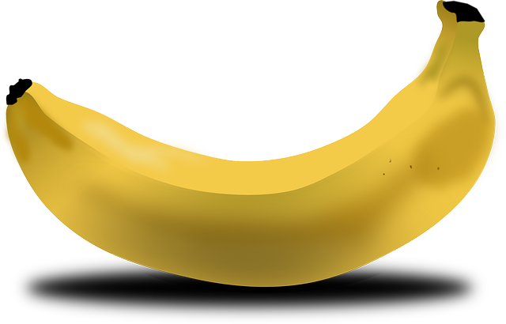

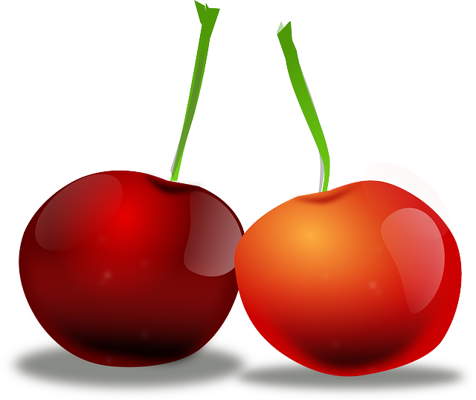
Practice: Printing a List
Given a list of strings called food, use a for loop to print out that each food is yummy!
  food = ["apples", "bananas", "cherries", "durians"]
  # for loop goes here
  for f in food:
  print(f, "are yummy!")
apples are yummy!
bananas are yummy!
cherries are yummy!
durians are yummy!
Images from pixabay.com
Notes:
https://pixabay.com/en/apple-green-fruit-juicy-nature-33709/
https://pixabay.com/en/banana-fruit-food-yellow-bent-151553/
https://pixabay.com/en/cherries-fruit-natural-diet-fresh-42904/
https://pixabay.com/en/durian-fruit-fruit-food-durio-154723/

Slide 37
The range() function

Slide 38
Range of Numbers
Python has a built-in function called range() that can generate a list of numbers
  ex = list(range(0, 10))
  print(ex)
cast it to a list to force it generate the numbers now
like slicing – it’s UP TO (but not including) 10
[0, 1, 2, 3, 4, 5, 6, 7, 8, 9]

Slide 39
Syntax of range()
range(start, stop, step)
the number we want to start counting at
how much we want to count by
the number we want to count UP TO (but will not include)
the name of the function

Slide 40
Using range() in a for Loop
We can use the range() function to control a loop through “counting”
  for i in range(0, 20):
  print(i + 1)
What will this code do?
  Print the numbers 1 through 20 on separate lines

Slide 41
Examples of range()
There are three ways we can use range()
With one number
  range(10)
With two numbers
  range(10, 20)
With three numbers
  range(0, 100, 5)

Slide 42
range() with One Number
If range() is given only one number
  It will start counting at 0
  And will count up to (but not including) that number
  Counting by ones
  for p in range(4):
  print(p)
0
1
2
3

Slide 43
range() with Two Numbers
If we give it two numbers, it will count from the first number up to the second number
  for a in range(5,10):
  print(a)
  for b in range(10,5):
  print(b)
5
6
7
8
9
range() counts up by default!

Slide 44
range() with Two Numbers
If we give it two numbers, it will count from the first number up to the second number
  for c in range(-10, -5):
  print(c)
-10
-9
-8
-7
-6
from a lower to a higher number

Slide 45
range() with Three Numbers
If we give it three numbers, it will count from the first number up to the second number, and it will do so in steps of the third number
  >>> threeA = list(range(2, 11, 2))
  >>> print(threeA)
  [2, 4, 6, 8, 10]
  >>> threeB = list(range(3, 28, 5))
  >>> print(threeB)
  [3, 8, 13, 18, 23]
range() starts counting at the first number!

Slide 46
Counting Down with range()
By default, range() counts up
  But we can change this behavior
If the STEP is set to a negative number, then range() can be used to count down
  >>> downA = list(range(10, 0, -1))
  >>> print(downA)
  [10, 9, 8, 7, 6, 5, 4, 3, 2, 1]

Slide 47
Using range() in for Loops
When we use the range() function in for loops, we don’t need to cast it to a list
  The for loop handles that for us
  print("Counting by fives...")
  for num in range(5, 26, 5):
  print(num)
5
10
15
20
25
call the range() function, but don’t need to cast it to a list

Slide 48
Combining for and range()

Slide 49
Using a for Loop with range()
We can combine a simple for loop with the range() function, as shown below
  for i in range( len(theList) ):
  print( theList[i] )
What’s the benefit to doing it this way?
Why do we need range() and len()?
  We’ll answer these questions momentarily

Slide 50
Contents vs Indexes
Previously, we had used the for loop to
iterate over the contents of the list
  For example: “a”, “b”, “c”, “d”
Just now, we used it the for loop to
iterate over the indexes of the list
  For example: 0, 1, 2, 3

Slide 51
Time for…
LIVECODING!!!

Slide 52
Running a Kennel
You are running a kennel with space for 5 dogs
You ask your 3 assistants to do the following, using the list of dogs in your office:
  Tell you all of the dogs in the kennel
  Tell you what pen number each dog is in
  Later, all the dogs have been picked up, and someone dropped off their 5 German Shepherds, so the list in your office needs to be updated

Slide 53
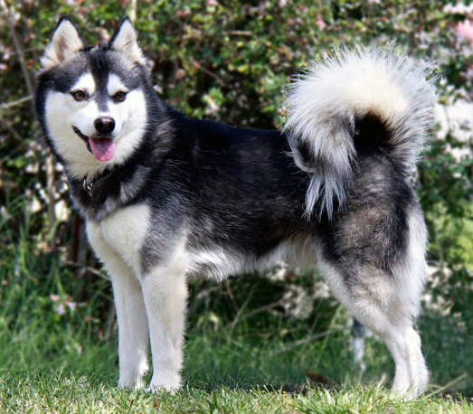
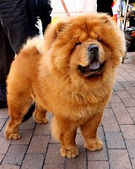
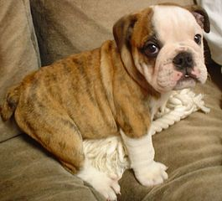
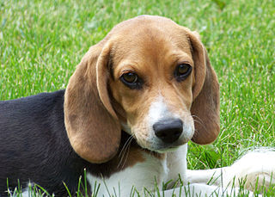
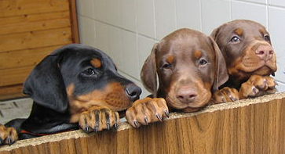
Running a Kennel
The dogs in your kennel at the start are:
Alaskan Klee Kai | Beagle | Chow Chow | Doberman | English Bulldog
Images from wikimedia.org
Notes:
https://commons.wikimedia.org/wiki/File:WOWAKK-Kukai-Alaskan-Klee-Kai.jpg
https://commons.wikimedia.org/wiki/File:Cute_beagle_puppy_lilly.jpg
https://commons.wikimedia.org/wiki/File:01_Chow_Chow.jpg
https://commons.wikimedia.org/wiki/File:Dobermannwurf.jpg
https://commons.wikimedia.org/wiki/File:English_Bulldog_puppy.jpg

Slide 54
Benefits of Iterating with for
Iterating over the indexes allows us to actually access (and change!) the contents of the list
The for loop handles the necessary updating of the loop variable for us
  Python may be “stupid,” but it won’t
  make coding mistakes like we might

Slide 55
Why range() and len()?
Why do we need len()?
  To know how many indexes the list has
  It will give us an integer value
Why do we need range()?
  To generate all the indexes of the list
What does range() do with one number?
  Start at 0, and count up to the number given

Slide 56
Common Error
Pay attention with len() and range()
Which goes on the outside?
  range()
  It needs the length to generate the indexes
If you use them backwards:
  TypeError: 'list' object cannot be interpreted as an integer

Slide 57
Announcements
Slides with problems are at the end of this lecture; use them to practice for loops
Homework 4 is due Wednesday
  Homework 2 grades will be sent to you soon
The midterm exam is fast approaching…
  October 19th and 20th!
  We’ll review in class on the 17th and 18th

Slide 58
Practice: The range() function
What lists will the following code generate?
  prac1 = list(range(50))
  prac2 = list(range(-5, 5))
  prac3 = list(range(1, 12, 2))

Slide 59
Practice: The range() function
What lists will the following code generate?
  prac1 = list(range(50))
  prac2 = list(range(-5, 5))
  prac3 = list(range(1, 12, 2))
[0, 1, 2, 3, 4, 5, ..., 47, 48, 49]
a list from 0 to 49, counting by 1
[-5, -4, -3, -2, -1, 0, 1, 2, 3, 4]
[1, 3, 5, 7, 9, 11]

Slide 60
Practice: Odd or Even?
Write code that will print out, for the numbers 1 through 20, whether that number is even or odd
  Sample output:
  The number 1 is odd
  The number 2 is even
  The number 3 is odd

Slide 61
Practice: Odd or Even?
Write code that will print out, for the numbers 1 through 20, whether that number is even or odd
  for num in range(1,21):
  # if odd, will be 1 (which is True)
  if (num % 2):
  print(num, "is odd")
  # if even, divides cleanly into 2
  else:
  print(num, "is even")

Slide 62
Practice: Indexing in a List
Alice | Bob | Eve
Using the list names,
code the following:
  Print “Bob sends a message to Alice”
  Change the first element of the list to Ann
  Print “BobBobAnnEve”

Slide 63
Practice : Indexing in a List
0 | 1 | 2
Alice | Bob | Eve
Using the list names,
code the following:
  Print “Bob sends a message to Alice”
  Change the first element of the list to Ann
  Print “BobBobAnnEve”
Ann
print(names[1], "sends a message to", names[0])
names[0] = "Ann"
print(names[1] + names[1] + names[0] + names[2])
# or print(names[1]*2 + names[0] + names[2])

Slide 64
Practice Problem
Write a program that asks the user for input:
  The height and width of a parallelogram
Print a parallelogram with those dimensions to the user’s screen
bash-4.1$ python lec8_practice1.py
What is the height of your parallelogram? 4
What is the length of your parallelogram? 7
*******
*******
*******
*******

Slide 65
Practice Problem
Write a program that asks the user to enter a positive integer, and calculates the sum of
1² + 2² + ... + n² and prints it to the screen
  For example, if the user entered 5, the program would calculate 1² + 2² + 3² + 4² + 5²
  = 1 + 4 + 9 + 16 + 25 = 55
bash-4.1$ python lec8_practice2.py
Enter a positive integer: 4
The sum of the first 4 squares is 30.

